Slide 1
Basic Cache Organizations

Slide 2
Memory Hierarchy Questions
Data transferred between cache & memory are in blocks
Block placement - where can a block be placed in the upper level?
Block identification – how to find a block in the upper level?
Block replacement - which block should be replaced on a miss?
Write strategy – how to handle writes?
B.1 Introduction

Slide 3
Basics
When a word is found in cache --> cache hit.
When a word is not found in the cache, a miss occurs:
Fetch word from lower level in hierarchy does not reduce latency
Lower level may be another cache or the main memory
Also fetch the other words contained within the block
Takes advantage of spatial locality
Place block into cache in any location within its set, determined by address
word
block
Main
Memory
CPU
Cache
B.1 Introduction
Notes:
Why do we fetch a block instead of a single word?

Slide 4
Basics
Inclusive cache (considered for this class)
Exclusive cache
L2$
L1$
CPU
L2$
L1$
CPU
B.1 Introduction
Notes:
Inclusive -- miss penalty is less
Exclusive – higher miss penalty, less memory waste
Exclusive cache might not work well in multiprocessor as requested data only exists in a remote cache → longer access latency

Slide 5
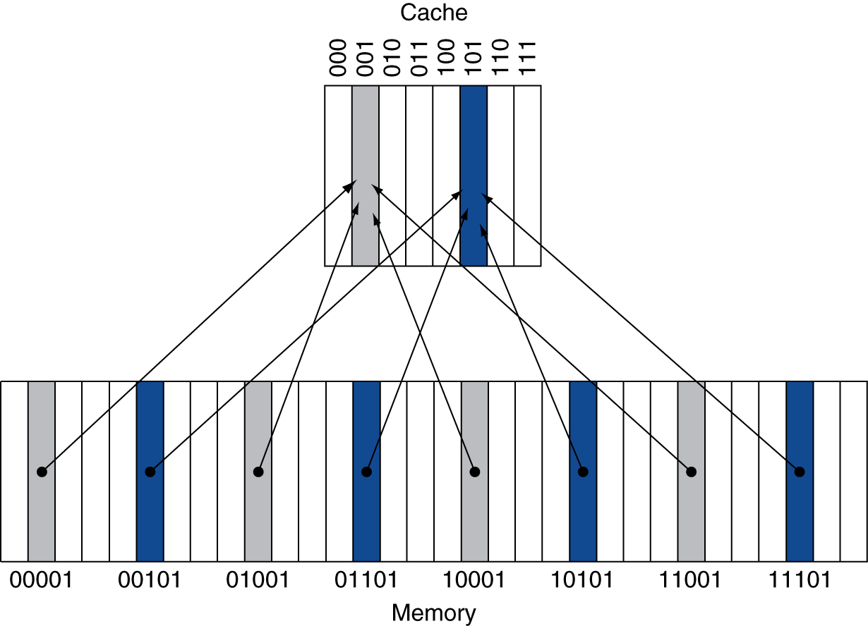
Direct Mapped Cache
Only one choice
cache index = (Block address) MOD (#Blocks in cache)
#Blocks is a power of 2
Use low-order address bits to access bytes in a block
B.1 Introduction
Notes:
Q: what are block address and block offset used for?

Slide 6
Tags and Valid Bits
One cache line ← Multiple memory blocks
Cache line is aka cache block
How do we know which particular memory block is stored in a cache location?
For write, store tag bits as well as the data
For read, match tags in addressed and that stored in $
What if there is no data in a location?
Valid bit: 1 = present, 0 = not present
Initially 0
B.1 Introduction

Slide 7
Example: Larger Block Size
Cache: 64 blocks, 16 bytes/block
To what cache block number does address 1200 (decimal) map?
Assume 32-bit address
Byte-addressable
V
tag
block 0
V
tag
block 1
address
…
32
V
tag
block 63
B.1 Introduction

Slide 8
Example: Larger Block Size
Cache: 64 blocks, 16 bytes/block
To what block number does address 1200 map?
Block address = ⎣1200/16⎦ = 75
Block offset value = 1200 modulo 16 = 0
Cache block index = 75 modulo 64 = 11
31
10
9
4
3
0
Tag
Index
Offset
22 bits
6 bits
4 bits
B.1 Introduction

Slide 9
Cache Example
8-blocks, 1 word/block, direct mapped
Initial state
Index | V | Tag | Data
000 | 0
001 | 0
010 | 0
011 | 0
100 | 0
101 | 0
110 | 0
111 | 0
Gray area is what’s actually included in cache
B.1 Introduction

Slide 10
Cache Example
Word addr | Binary addr | Hit/miss | Cache block
22 | 10 110 | Miss | 110
1
Index | V | Tag | Data
000 | 0
001 | 0
010 | 0
011 | 0
100 | 0
101 | 0
110 | 1 | 10 | Mem[10110]
111 | 0
compulsory
miss
B.1 Introduction

Slide 11
Cache Example
Word addr | Binary addr | Hit/miss | Cache block
26 | 11 010 | Miss | 010
2
Index | V | Tag | Data
000 | 0
001 | 0
010 | 1 | 11 | Mem[11010]
011 | 0
100 | 0
101 | 0
110 | 1 | 10 | Mem[10110]
111 | 0
B.1 Introduction

Slide 12
Cache Example
Word addr | Binary addr | Hit/miss | Cache block
16 | 10 000 | Miss | 000
3 | 00 011 | Miss | 011
16 | 10 000 | Hit | 000
3
4
5
Index | V | Tag | Data
000 | 1 | 10 | Mem[10000]
001 | 0
010 | 1 | 11 | Mem[11010]
011 | 1 | 00 | Mem[00011]
100 | 0
101 | 0
110 | 1 | 10 | Mem[10110]
111 | 0
B.1 Introduction

Slide 13
Cache Example
Word addr | Binary addr | Hit/miss | Cache block
18 | 10 010 | Miss | 010
Index | V | Tag | Data
000 | 1 | 10 | Mem[10000]
001 | 0
010 | 1 | 10 | Mem[10010]
011 | 1 | 00 | Mem[00011]
100 | 0
101 | 0
110 | 1 | 10 | Mem[10110]
111 | 0
B.1 Introduction

Slide 14
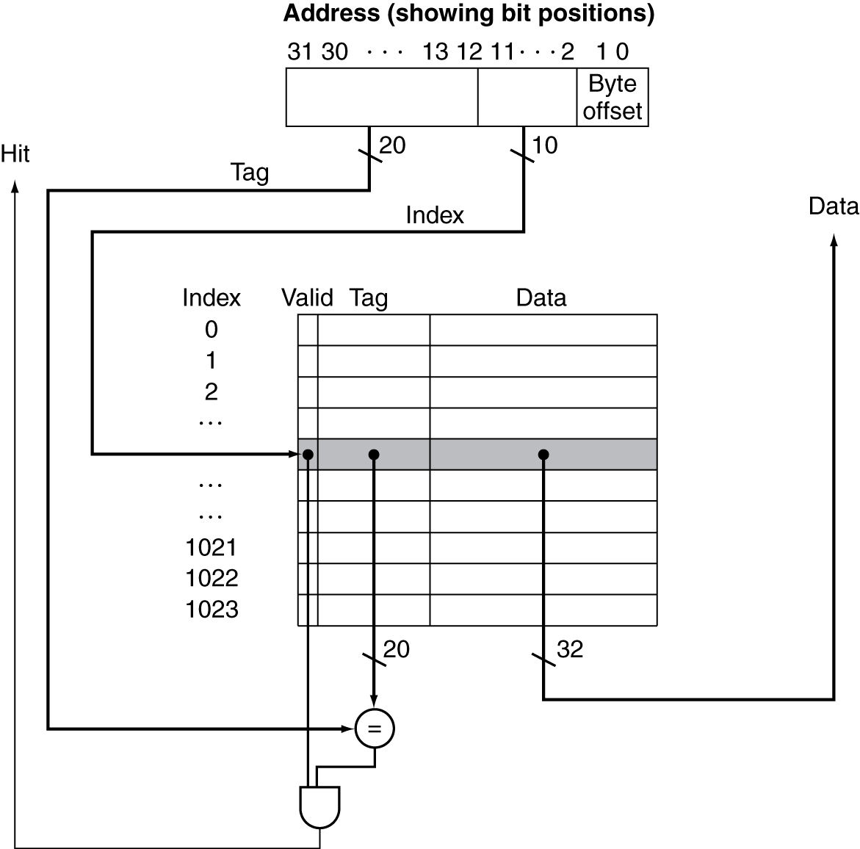
Address Subdivision
← from CPU
1
2
3
B.1 Introduction
Notes:
Operations for cache hit and miss

Slide 15
Cache Misses
On cache hit, CPU proceeds normally
On cache miss
Stall the CPU
Fetch a block from next level of mem. hierarchy
Instruction cache miss
Restart instruction fetch
Data cache miss
Complete data access
B.1 Introduction
Notes:
Note that speculative and multithreaded processors may execute other instructions during a miss
Reduces performance impact of misses

Slide 16
Cache Misses
Miss rate
Fraction of cache access that result in a miss
Miss Penalty – time to access lower level memory
Causes of misses
Compulsory
First reference to a block
Capacity
Blocks discarded and later retrieved due to cache capacity limit
Conflict
Program makes repeated references to multiple addresses from different blocks that map to the same location in the cache
Only happen in direct-mapped or set associative caches
2.1 Introduction

Slide 17
Measuring Cache Performance
CPU time = (CPU cycles + mem stall cycles) * cycle time
CPU cycles = IC*Ideal CPI (CPU cycles under cache hits)
Memory stall cycles = additional cycles for handling cache misses
latency of accessing lower-level memory
Stall cycles per instruction
B.1 Introduction
Notes:
CPU cycles = IC * Ideal CPI
CPU time = IC *(hit cycles + mem access/inst * miss rate * miss penalty) * cycle time

Slide 18
Cache Performance – Example
Given
I-cache miss rate = 2%
D-cache miss rate = 4%
Miss penalty = 100 cycles
Base CPI (ideal cache) = 2 cycles (aka ideal CPI)
Load & stores are 36% of instructions
Stall cycles per instruction
I-cache: 1 × 0.02 × 100 = 2
D-cache: 0.36 × 0.04 × 100 = 1.44
Actual CPI = 2 + 2 + 1.44 = 5.44
Ideal CPU is 5.44/2 =2.72 times faster
B.1 Introduction
Notes:
What about performance if there is no cache?

Slide 19
Cache Performance - Average Access Time
Hit time is also important for performance
Average memory access time (AMAT)
Example
CPU with 1ns clock cycle time, hit time = 2 cycle, miss penalty = 20 cycles, I-cache miss rate = 5%
AMAT = 2 + 0.05 × 20 = 3 cycles
AMAT = Hit time + Miss rate × Miss penalty
B.2 Cache Performance
Notes:
Time here can be clock cycles or physical time.
Question: why not AMAT = hit time * (1-Miss rate) + Miss rate * Miss penalty?

Slide 20
Performance Summary
As CPU performance increased
Miss penalty becomes more significant
Increasing clock rate, and decreasing base CPI
Memory stalls lead to more CPU cycles
Greater proportion of time spent on memory stalls
Cannot neglect cache behavior when evaluating system performance
What does Amdahl’s law tell us?
How to reduce memory stalls?
B.2 Cache Performance

Slide 21
Associative Caches – Reduce Conflict Misses
Fully associative
Allow a given block to go in any cache entry
Requires all entries to be searched at once
Comparator per entry – expensive (area)
n-way set associative
Each set contains n entries
Block address determines the set
Cache index = (Block address) MOD (#Sets in cache)
Search all entries in a given set at once for correct one
n comparators (less expensive than fully associative)
Direct-mapped = 1-way associative
B.1 Introduction

Slide 22
Associative Cache Example
Fully Associative
Direct Mapped
2-way Associative
B.1 Introduction

Slide 23
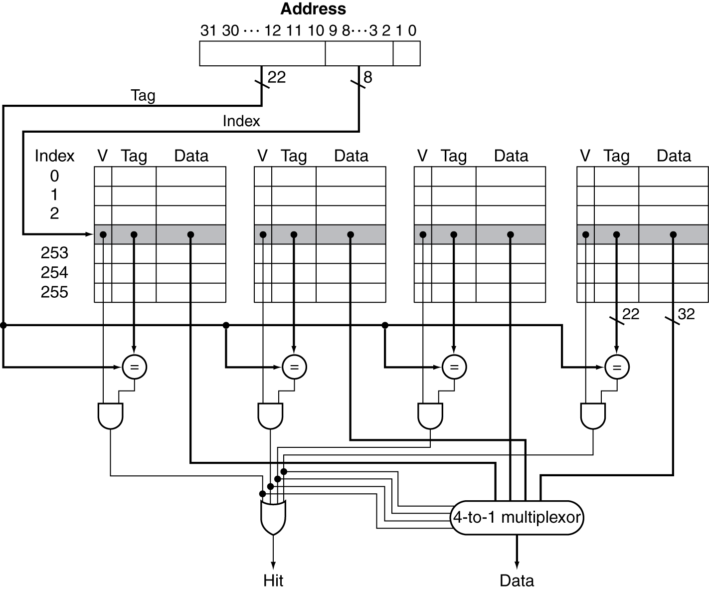
4-way Associative Cache Organization
1
2
3
Notes:
A cache index points to a set, which includes a number of cache blocks.

Slide 24
Associativity Example
Compare 4-block caches, block size = 1 byte
Direct mapped, 2-way set associative, fully associative
Sequence of addresses: 0, 8, 0, 6, 8
Direct mapped
Address 0
Address 8
Address 0
Address 6
Address 8
0
1
2
3
Mem[0]
Mem[8]
Mem[0]
Mem[0]
Mem[6]
Mem[8]
Mem[6]
5 misses (their types?)
B.1 Introduction
Notes:
What types of misses can be found from the table?

Slide 25
Associativity Example
2-way set associative
Address 0
Address 8
Address 0
Address 6
Address 8
0
1
Mem[0]
Mem[0]
Mem[8]
Mem[0]
Mem[8]
Mem[0]
Mem[6]
Mem[8]
Mem[6]
B.1 Introduction

Slide 26
Associativity Example
Fully associative
Address 0
Address 8
Address 0
Address 6
Address 8
Mem[0]
Mem[0]
Mem[8]
Mem[0]
Mem[8]
Mem[0]
Mem[8]
Mem[6]
Mem[0]
Mem[8]
Mem[6]
B.1 Introduction

Slide 27
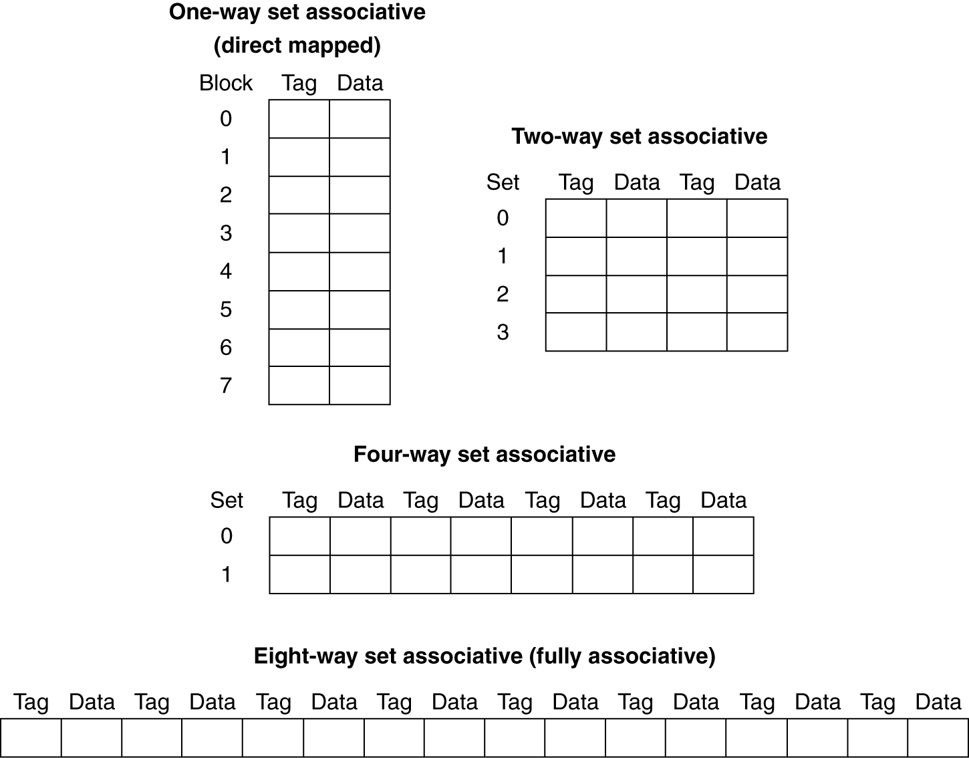
Spectrum of Associativity
For a cache with 8 entries
B.1 Introduction
Notes:
Given a fixed sized cache, increasing associativity → decreasing number of sets, and block address bits, increasing tag bits
Increasing tag bits → longer latency to compare

Slide 28
Size of Tags vs Associativity
No. address bits = 32
Block size = 4 bytes
Cache size = 16KB →
Direct mapping
Tag bits = 18x2¹²
Comparators = 1
4-way set-associative
Tag bits= 4x2¹⁰x20 = 20x2¹²
Comparators = 4
Fully associative
Tag bits = 30x2¹²
Comparators = 2¹²
31 14
13 2
1 0
18 bits
31 12
11 2
1 0
20 bits
31 2
1 0
30 bits
B.1 Introduction
Notes:
As the associativity increases, the number of tag bits stored in cache also increases
→ large circuit overhead,
→ longer latency,
→ higher energy consumption.

Slide 29

Size of Tags vs Associativity
Increasing associativity requires
More tag bits per cache block
More comparators, each of which is more complex
higher hit time, larger circuits
The choice among direct, set-associative and fully-associative mapping in any memory hierarchy will depend on
Miss rate vs cost of implementing associativity, both in time and in extra hardware overhead
AMAT = Hit time$↑$ + (Miss rate$↓$) × Miss penalty
B.1 Introduction

Slide 30
Replacement Policy
Direct mapped: no choice
Set associative
Prefer non-valid entry, if there is one
Otherwise, choose among entries in the set
Least-recently used (LRU)
Choose the one unused for the longest time
Simple for 2-way, manageable for 4-way, too hard otherwise
FIFO approximates LRU – replace the oldest block
Random
Gives approximately the same performance as LRU for high associativity
B.1 Introduction
Notes:
Replacement policy is about conflict or capacity misses

Slide 31
Write Policy – Write-Through
Update cache and memory together
Cache and memory data remain the same
Easier to implement
Writes take longer – wait for mem update to complete
e.g., if base CPI = 1, 10% of instructions are stores, memory write latency is 100 cycles
Effective CPI = 1 + 0.1×100 = 11
CPU
Cache
Memory
B.1 Introduction

Slide 32
Write-Through with Write Buffer
Write buffer – holds data waiting to be written to memory
CPU write to cache & write buffer
Then, CPU continues immediately
Only stalls on write if write buffer is full
Evict write buffer to memory
Write buffer is freed when write-to-memory is finished
CPU
Cache
WBuf
Memory
B.1 Introduction

Slide 33
Write Policy – Write-Back
Just update the block in cache
Keep track of whether each block is dirty - dirty bits
Inconsistent data in $ and Mem
When a dirty block is replaced, write it back to memory
Write speed is faster
One low-level memory update for multiple cache writes.
Energy saving.
Write buffer can also be used
CPU
Cache
Memory
B.1 Introduction

Slide 34
Write Allocation
What should happen on a write miss?
Write allocate
No-write allocate
Alternatives for write-through
Write-allocate: fetch the block, then write-through
No-write allocate: update memory w/o fetching the block
For write-back
Usually fetch the block – write-allocate
Act like read misses
B.1 Introduction
Notes:
No-write allocate: aka write-around

Slide 35
Write Miss Policies – Example
write M[100]
write M[100]
read M[200]
write M[200]
write M[100]
Assume fully associative cache
Find number of misses for the following write policies
Write-through cache with No-write allocate
Write-back cache with Write allocate
B.1 Introduction

Slide 36
Handling Writes
 | Allocate | Non-Allocate
Write-Back | Allocate on write miss flush dirty blocks only when replaced write on hit only accesses cache | Write to mem on miss no cache block fetch
Write-Through | Allocate on write miss Write to cache & mem in parallel | Write to mem on miss no cache block fetch

Slide 37
Cache Performance – Example
Base CPI = 1,
cycle time = 1ns
Hit time(DM) = 1 cycle
Miss rate (DM) = 0.021
Hit time (2-way) = 1.35 cycles
Miss rate (2-way) = 0.019
Miss penalty = 150 cycles
Avg mem. req/inst = 1.4
Which cache is faster using AMAT?
B.1 Introduction
Notes:
amat is an indirect measure of system performance.
A better measure is CPU time considering memory stall cycles due to cache misses.

Slide 38
Cache Performance – Example
Base CPI = 1,
cycle time = 1ns
Hit time(DM) = 1 cycle
Miss rate (DM) = 0.021
Hit time (2-way) = 1.35 cycles
Miss rate (2-way) = 0.019
Miss penalty = 150 cycles
Avg mem. req/inst = 1.4
Which cache is faster using CPU time?
B.1 Introduction
Notes:
amat is an indirect measure of system performance.
A better measure is CPU time considering memory stall cycles due to cache misses.

Slide 39
Cache Performance – Exercise
Base CPI = 1,
cycle time = 1ns
Hit time(DM) = 1 cycle
Miss rate (DM) = 0.021
Hit time (2-way) = 1.35 cycles
Miss rate (2-way) = 0.019
Miss penalty = 200 cycles
Avg mem. req/inst = 1.4
Which cache is faster?
B.1 Introduction
Notes:
amat is an indirect measure of system performance.
A better measure is CPU time considering memory stall cycles due to cache misses.

